Slide 1
Introduction to endocrinology
Dicky Moch Rizal
Dept. Of Physiology, Fac. Of Medicine, Gadjah Mada University

Slide 3
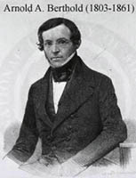
Arnold A Berthold (1803-1861)
In one of the first endocrine experiments ever recorded, Professor Arnold A. Berthold of Gottingen did a series of tests on roosters in 1849 while he was curator of the local zoo.

Slide 4
Ablation and replacement
Bethold found that a rooster's comb is an androgen-dependent structure. Following castration, the comb atrophies, aggressive male behavior disappears, and interest in the hens is lost.
Importantly, Berthold also found that these castration-induced changes could be reversed by administration of a crude testicular extract (or prevented by transplantation of the testes).

Slide 5
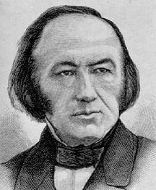
Claude Bernard
(1813-1878)
Claude Bernard stated that the endocrine system regulates the internal milieu of an animal. The “internal secretions” were liberated by one part of the body, traveled via the bloodstream to distant targets cells. Circa 1854
Bernard's charge was to demonstrate that medicine, in order to progress, must be founded on experimental physiology.

Slide 6
Claude Bernard (in 1872) found that a regulated internal environment (le milieu intérieur) in a changing, and challenging, environment was noteworthy.
He noted that cells and tissues need to communicate for coordination of physiological activities.

Slide 7
The presentation of a paper in 1889 to the Societe de Biologie in Paris by Charles-Edouard Brown-Séquard, a professor at the College de France and one of the most distinguished physiologists of the 19th century.
Brown-Séquard reported that self-administration of aqueous extracts of animal testes (guinea pig and dogs) had enhanced his physical strength, improved his intellectual capacity, and increased his sexual potency

Slide 8
Ernest Henry Starling (1866-1927)
Besides "his" law of the heart, Starling discovered the functional significance of serum proteins.
In 1902 along with Bayliss he demonstrated that secretin stimulates pancreatic secretion.
In 1924 along with E. B. Vernay he demonstrated the reabsorption of water by the tubules of the kidney.
He was the first to use the term hormone

Slide 9
Starling defined the word, derived from the Greek meaning 'to arouse or excite', as “the chemical messengers which speeding from cell to cell along the blood stream, may coordinate the activities and growth of different parts of the body”

Slide 10
Jim Ferguson 1947-2002
Famous cardiovascular physiologist
Truly understood “Starling’s Law”
Disputed that the main purpose of the cardiovascular system was to deliver hormones.

Slide 11
1889 | Brown-Séquard self-administers testis extracts
1891 | Murray treats myxoedema with thyroid extract
1894 | Oliver and Schaefer describe epinephrine
1903 | Bayliss and Starling discover secretin
1904 | Bouin and Ancel deduce role of the Leydig cell in male phenotypic differentiation
1909 | MacCallum and Voetlin discover link between parathyroid glands and calcium metabolism
1913 | Farmi and von den Velden treat diabetes insipidus with posterior pituitary extracts
1921 | Evans and Long describe growth hormone
1922 | Discovery of insulin by Banting and Best

Slide 12
In 1910, Artur Biedl, Professor of General and Experimental Pathology at the German University in Prague, published a textbook of endocrinology[that was promptly translated into English.
The book listed more than 8500 references, only about 1% of which had been published prior to 1889.
This averages to more than 400 papers a year during the first 20 years of the field.
The second edition in 1916 had almost 10 000 references.

Slide 13
Doisy, E.A. (1936) Sex Hormones. Porter Lectures Delivered at the University of Kansas School of Medicine. University of Kansas Press,Lawrence.
Identification of the tissue that produces a hormone
Development of bioassay methods to identify the hormone
Preparation of active extracts that can be purified, using the relevant bioassay
Isolation, identification of structure, and synthesis of the hormone.

Slide 14
The most dramatic example of early hormone development is that of epinephrine.
In 1894 George Oliver, a physician in Harrogate, had the idea that patients with low blood pressure might benefit from extracts of the adrenal.
Therefore, he prepared a glycerin extract of beef adrenal medulla obtained from the local butcher, injected the extract into his son, and observed contraction of the boy's radial artery

Slide 15
The endocrinology today resembles the field in the early twentieth century.
The profound changes in the field in the past 75 years are largely due to the application of advances in other fields chemistry, physics, cell and molecular biology, genetics, immunology, neuroscience and cybernetics so that hormones are now discovered, synthesized, measured and investigated in new ways

Slide 16
The endocrine and nervous systems are the major controllers of the flow of information between different cells and tissues (control & communication system)
The term:
endocrine: internal secretion of biologically active substances
exocrine: secretion outside the body through sweat glands or ducts that lead into the gastrointestinal tract

Slide 17
If we are talking about hormones, we always have to think about:
the name
the glands/cells
the target cells
the function in the target cells
the stimulators
the inhibitors
feedback mechanism

Slide 18
The word endocrine derives from the Greek words "endo" meaning inside, within, and "crinis" for secrete.
The endocrine system is an information signal system like the nervous system, yet its effects and mechanism are classifiably different.

Slide 19
Hormones travel via the bloodstream to target cells
The endocrine system broadcasts its hormonal messages to essentially all cells by secretion into blood and extracellular fluid. Like a radio broadcast, it requires a receiver to get the message - in the case of endocrine messages, cells must bear a receptor for the hormone being broadcast in order to respond.

Slide 21
Nervous system
The nervous system exerts point-to-point control through nerves, similar to sending messages by conventional telephone. Nervous control is electrical in nature and fast.

Slide 22
Communication Pathways
Similarities between neural and endocrine pathways?

Slide 23
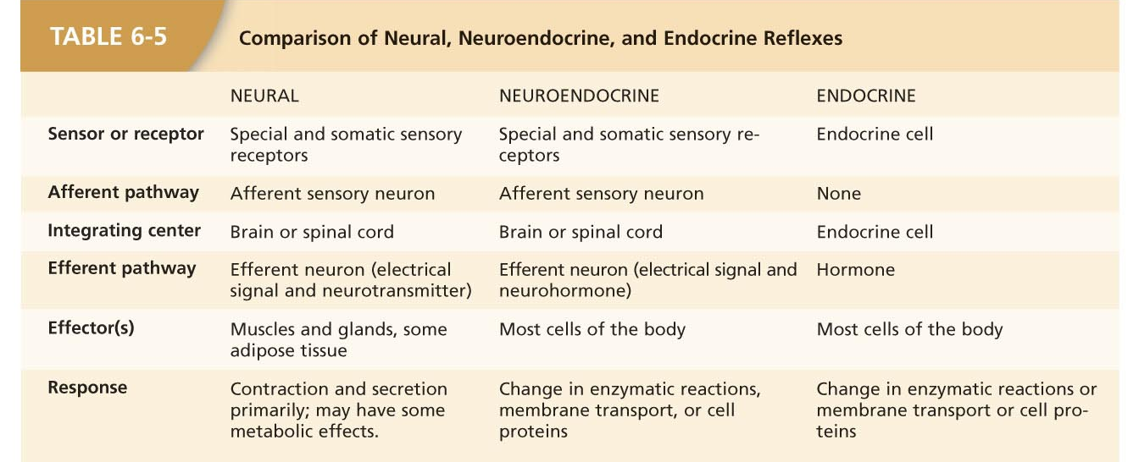
Communication Pathways
The homeostatic pathways are

Slide 24
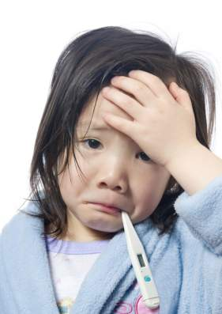
Remember, external means coming from outside of your body and internal means coming from inside of your body.

Slide 25
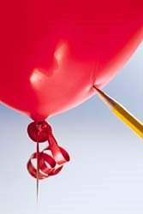
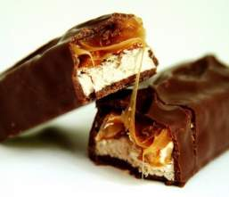
Stimulus:
You hear a loud noise
A large dog runs toward you, growling and barking
You eat a large candy bar
You have not eaten in six hours
You have strep throat
Notes:
Ask the students to classify these stimuli as external, internal, or combination of both.
Pictures from:
http://www.terrylove.com/images/mean_dog.jpg
http://ww-recipes.net/wp-content/uploads/2008/07/weight-watchers-snickers-candy-bar-recipe.jpg
http://4.bp.blogspot.com/_axq6RYBy3y0/SdhgTpVDTKI/AAAAAAAAAQM/o2qCmfSVHIg/s400/balloon-pop.jpg

Slide 26
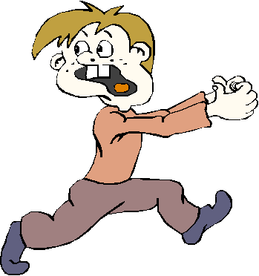
A chain of events occur that lead from the stimulus to the response.
Notes:
Picture from:
http://geekswithblogs.net/images/geekswithblogs_net/jkhines/Running_Away.gif

Slide 27
Regulation of hormone secretion, normally prevents overproduction or underproduction any of the hormone
Hormone secretion is regulated by:
signal from nervous system
chemical changes in the blood
others / hormones

Slide 28
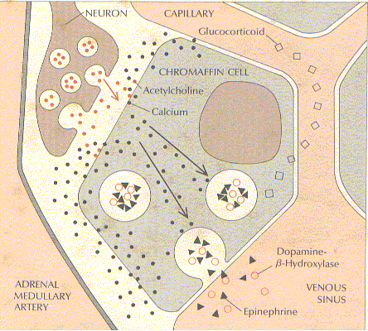
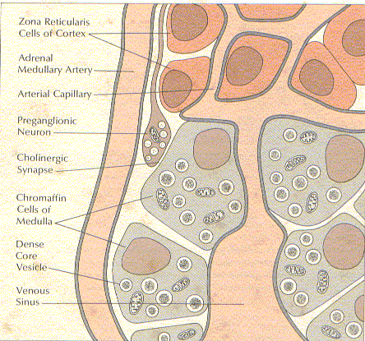
Signal from the nervous system

Slide 29
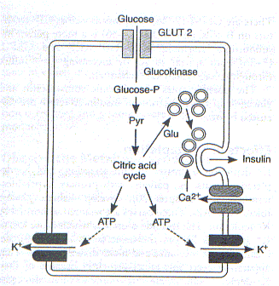
Chemical changes in the blood

Slide 30
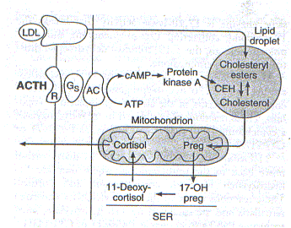
Others / hormones

Slide 31
Endocrine system maintains homeostasis
The concept that hormones acting on distant target cells to maintain the stability of the internal milieu was a major advance in physiological understanding.
The secretion of the hormone was evoked by a change in the milieu and the resulting action on the target cell restored the milieu to normal. The desired return to the status quo results in the maintenance of homeostasis

Slide 32
Principal functions of the endocrine system
Maintenance of the internal environment in the body (maintaining the optimum biochemical environment).
Integration and regulation of growth and development.
Control, maintenance and instigation of sexual reproduction, including gametogenesis, coitus, fertilization, fetal growth and development and nourishment of the newborn.

Slide 33
The endocrine system is composed of various glands located throughout the body
These glands are capable of synthesizing and releasing special chemical messengers called hormones

Slide 34
The endocrine glands respond to specific signals by synthesizing and releasing hormones into the circulation
The endocrine and nervous system work together to regulate responses to the internal and external environments

Slide 35
In addition to the specialised endocrine organs mentioned above, many other organs that are part of other body systems, such as the kidney, liver and gonad have secondary endocrine functions.
For example the kidney secretes endocrine hormones such as EPO and renin

Slide 36
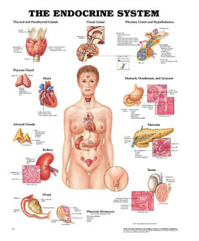

Slide 37
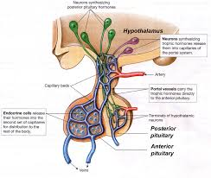

Slide 38
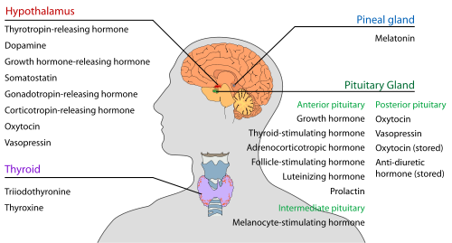

Slide 39
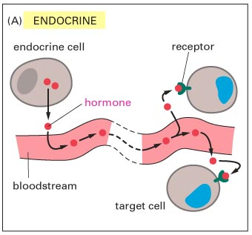
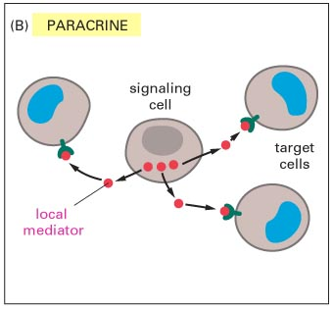

Slide 40
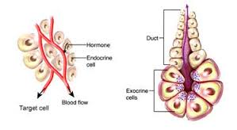
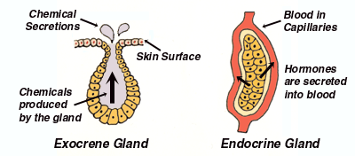
Endocrine and exocrine

Slide 41
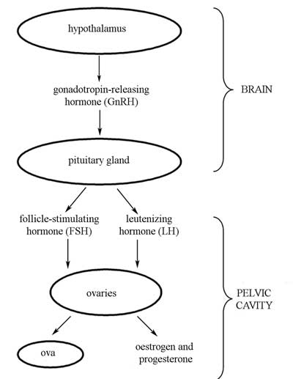
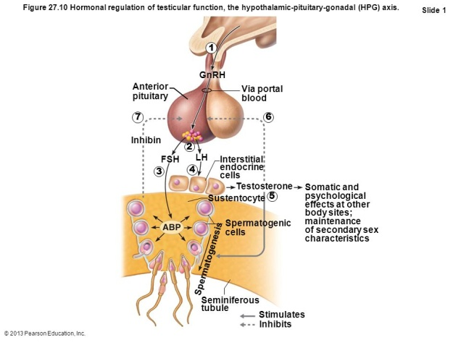
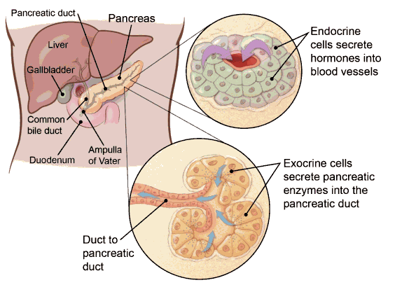
Exocrine and endocrine capability

Slide 43
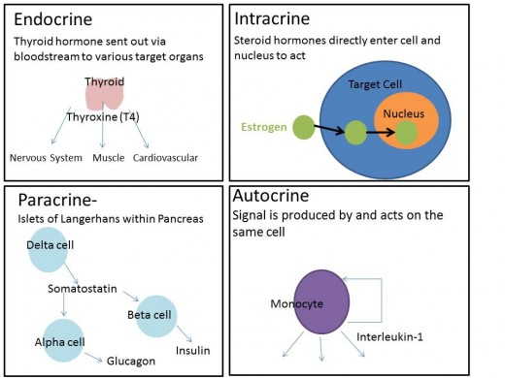

Slide 44
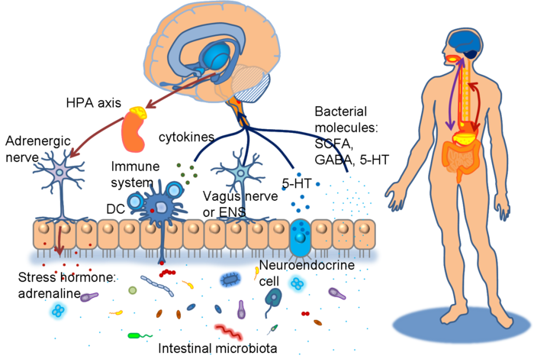
Mix interaction cytokine-hormone-neural system

Slide 45
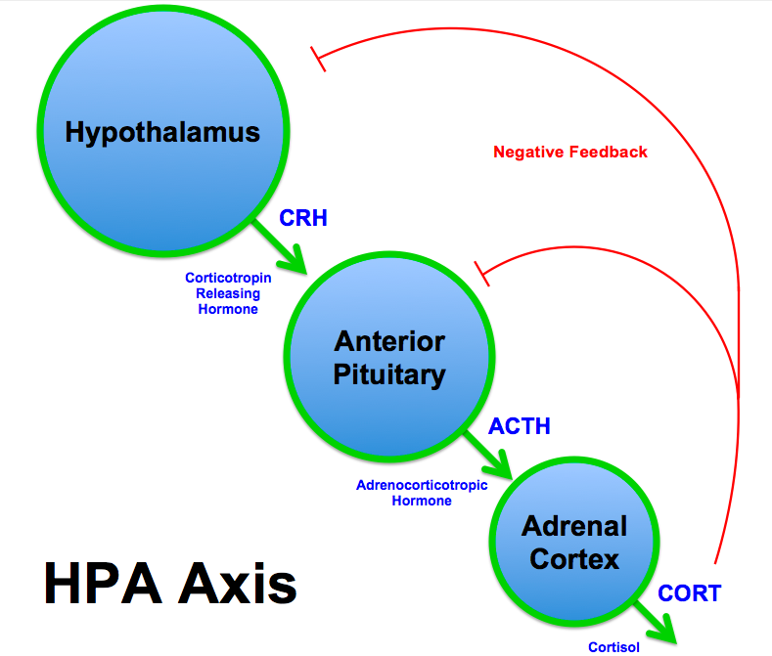
Hypothalamus-hypophysis-adrenal axis

Slide 46
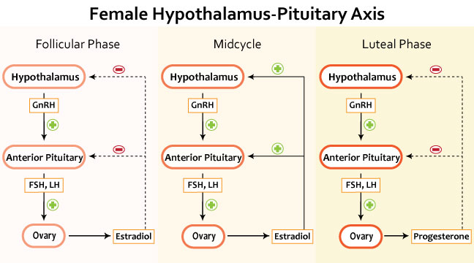
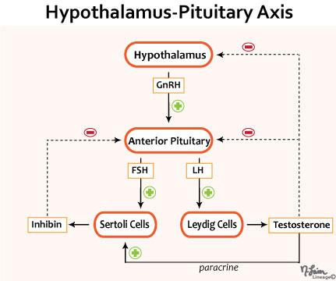
Hypothalamus-hypophysis-gonad axis

Slide 47
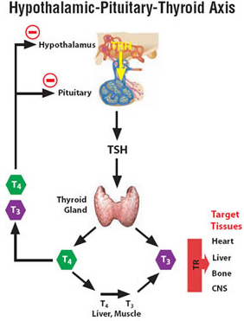
Hypothalamus-hypophysis-thyroid axis

Slide 48
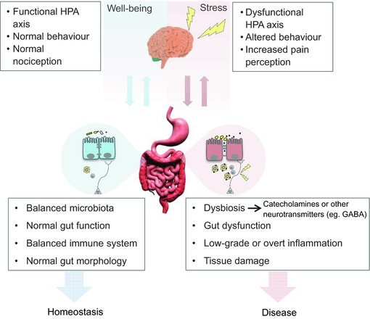
HPA axis and other system

Slide 49
Up and down regulation of hormone receptors

Slide 50
The biologic activity of individual hormones is dependent upon their interactions with specific high-affinity receptors on the surface (peptide and neurotransmitter) or in the cytoplasm (steroid hormones) or nuclear compartements (steroid hormones, thyroid hormone, vitamin D)

Slide 51
Amine-derived hormones are derivatives of the amino acids tyrosine and tryptophan. Examples are catecholamines and thyroxine.
Peptide hormones consist of chains of amino acids. Examples of small peptide hormones are TRH and vasopressin. Peptides composed of scores or hundreds of amino acids are referred to as proteins.

Slide 52
Examples of protein hormones include insulin and GH. More complex protein hormones bear carbohydrate side chains and are called glycoprotein hormones. LH, FSH and TSH are glycoprotein hormones.

Slide 53
Lipid and phospholipid-derived hormones derive from lipids such as linoleic acid and arachidonic acid and phospholipids. The main classes are the steroid hormones that derive from cholesterol and the eicosanoids.

Slide 54
Examples of steroid hormones are testosterone and cortisol. Sterol hormones such as calcitriol are a homologous system. The adrenal cortex and the gonads are primary sources of steroid hormones. Examples of eicosanoids are the widely studied prostaglandins

Slide 55
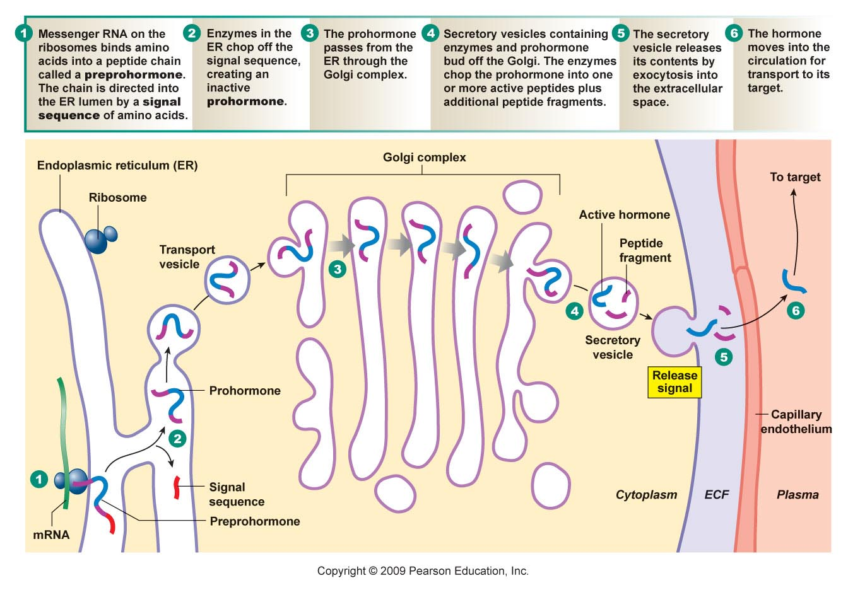
Hormone Classification
Peptide/protein hormones & how they are made, stored and released

Slide 56
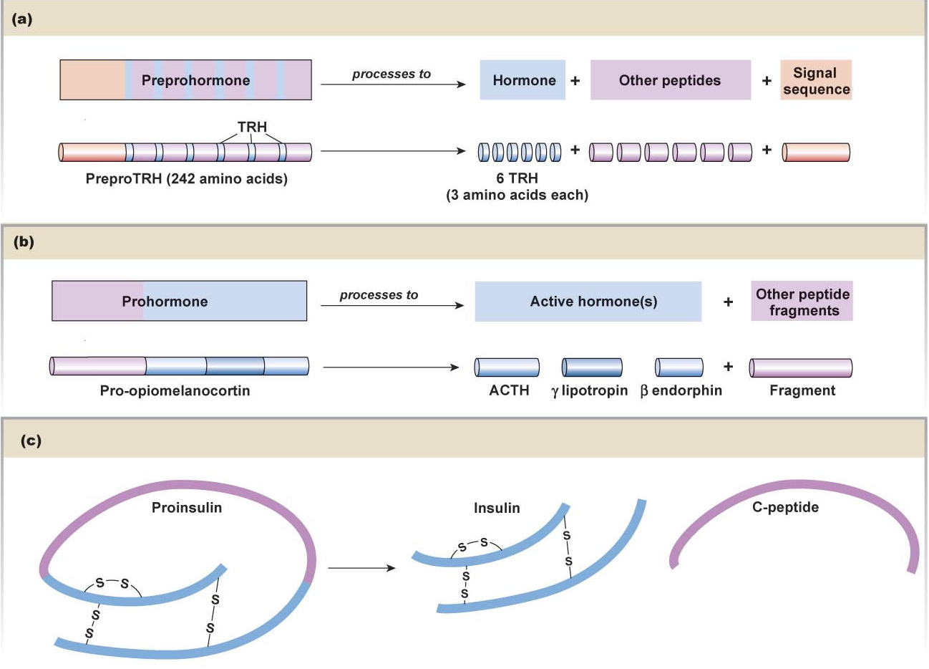
Hormone Classification
PreproTSH (thyrotropin releasing hormone) has six copies of the 3-amino acid hormones TRH
Examples of hormone processing
Prohormones may contain several peptide sequences that have biological activity
The peptide chain of insulin’s prohormone folds back and is cleaved into insulin & C-peptide

Slide 57
Hormone Classification
Peptide/protein hormones
Cellular action mechanism
Lipophobic – must bind to receptors on membrane’s ECF surface
Most work via cAMP messenger system
Some via receptor-enzyme complexes
Enzyme attached and activated by binding is tyrosine kinase (recall these enzymes phosphorylate various substrates)
Insulin binds, tyrosine kinase activated and phosphorylates glucose to glucose 6-phosphate

Slide 58
Communication Hormone Classification
Peptide/protein hormones
Duration
Depends on method of hormone action termination
Depends on molecule (some synthetic hormones have been modified to last longer)

Slide 59
Hormone Classification
Steroid Hormones
Lipophilic – creates problems
No storage
Production is on an “as needed” basis
Can have the precursors in cytoplasm ready to go
Require protein transports in blood
prolongs duration of hormone
Blocks entrance into cell… it must disengage from carrier
this follows law of mass action…

Slide 60
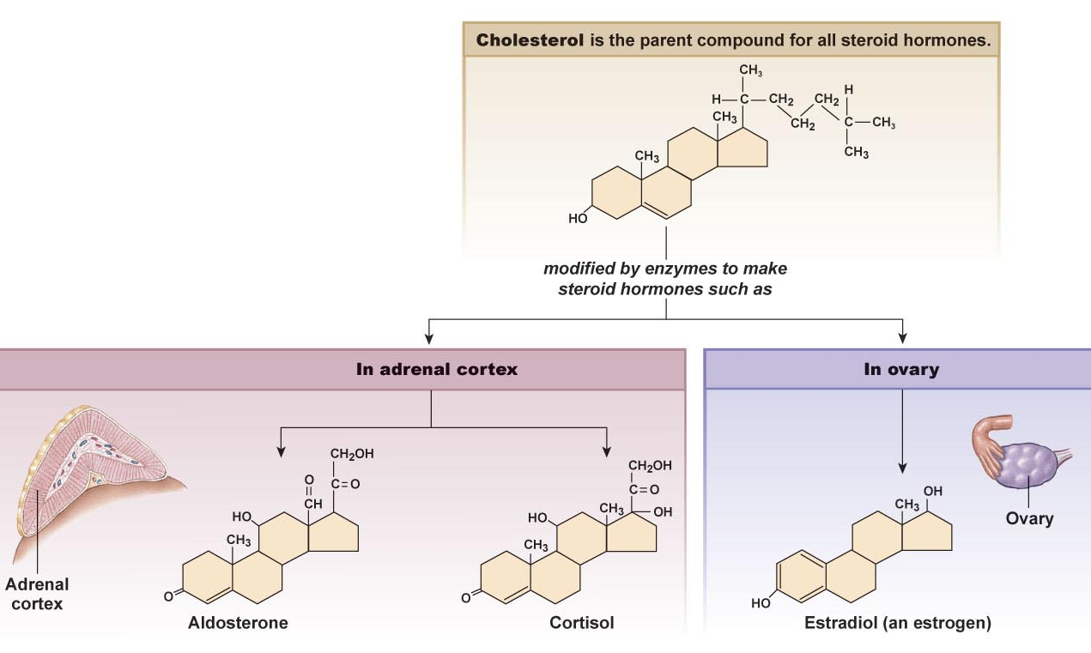
Hormone Classification
Steroid hormones
Based on cholesterol
Produced using SER in the
Adrenal cortex
Gonads
Placenta
Secretion is by simple diffusion

Slide 61
Communication Hormone Classification
Steroid Hormones
Cellular mechanism of action
Diffuses into cytosol and or into the nucleus
Acts as a transcription factors in the nucleus to alter gene activity by
Repressing or activating rates of transcription
Lag period due to the processes that have to occur
Transcription factors have DNA binding domains (DBDs) that tells them where to bind on the DNA (there are approx. 2000 known human transcription factors with specific DBDs
How are they regulated?
Negative feedback loop – increased transcription factors cause a decrease in production
Phosphorylation – may stop transcription
Ligand binding to transcription factors or cofactors that regulate the transcription factors…

Slide 62
New(er) research indicates that some steroid hormones have membrane receptors and signal transduction pathways similar in process to peptide/protein hormones
Nongenomic actions also attributed to aldosterone and estrogen

Slide 63
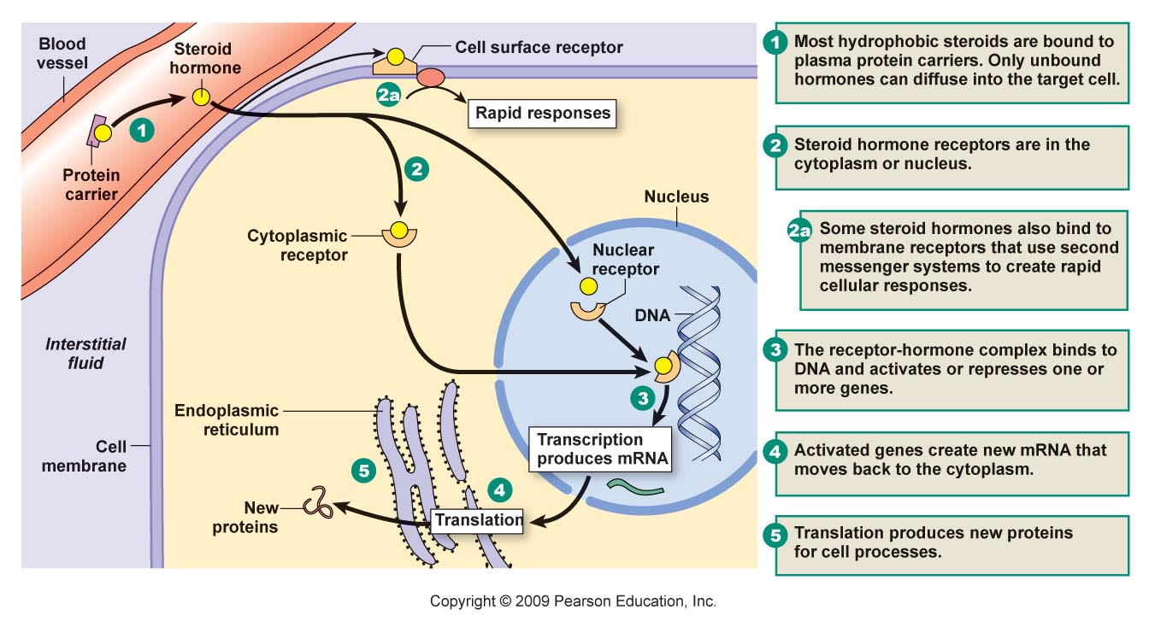
Hormone Classification
Steroid Hormone Action

Slide 64
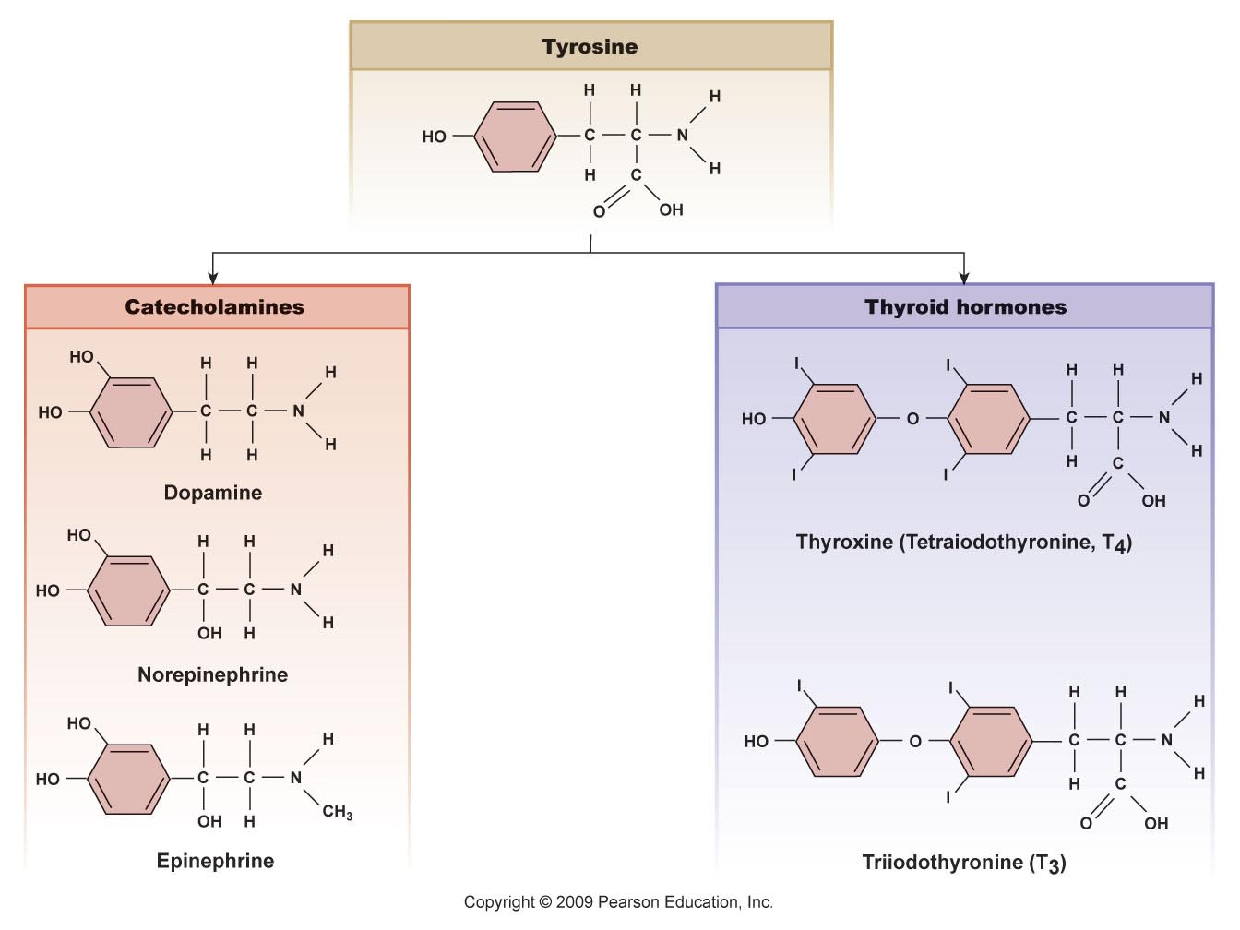
Hormone Classification
Amino acid derived hormones may be
Derived from tyrosine
Produces
T₃ & T₄
Epinephrine & norepinephrine

Slide 65
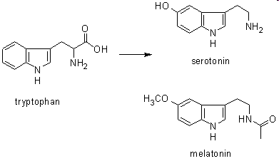
Hormone Classification
Amino acid derived hormones may be
Derived from tyrptophan
Produces
Melatonin
Serotonin*
*serotonin is classified as a neurohormone as it is synthesized and secreted by neurons of the GI tract for regulation of motility and CNS

Slide 67
The endocrine system has 5 general functions:
differentiation of the reproductive and central nervous systems in the developing fetus
stimulation of sequential growth and development during childhood and adolescenc
coordination of the male and female reproductive systems, which makes sexual reproduction possible
maintenance of an optimal internal environment throughout the life span
initiation of corrective and adaptive responses when emergency demands occur

Slide 68
Communication Hormones
What are they?
Chemical messengers secreted by specialized cells
from isolated endocrine cells which makes up the diffuse endocrine system
from neurons
from immune system cells producing cytokines
Where do they go?
Into blood (most)
Into environment (ectohormones or pheromones)

Slide 69
Communication Hormones
Involved in
Growth
Development
Metabolism
Reproduction
Act by
Altering rates of enzyme mediated reactions
Control the movement of molecules across the plasma membrane
Regulating the rate of gene expression (& therefore protein production)

Slide 70
The hormones have general characteristics:
hormones have specific rates and rhythms of secretion
The basic secretion patterns are:
diurnal patterns
pulsatile and cyclic patterns, and
patterns that depend on levels of circulating substrates

Slide 71
hormones operate within feedback systems, either positive or negative, to maintain an optimal internal environment
hormones affect only cells with appropriate receptors and then act on those cells to initiate specific cell function or activities
the kidneys excrete hormones, where as the liver metabolizes hormones, inactiviting them and rendering the hormone more water soluble for renal excretion

Slide 72
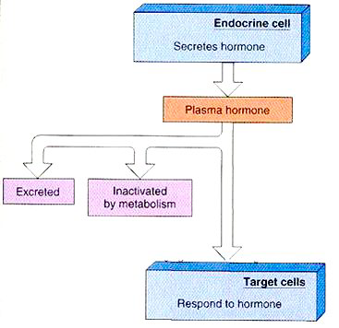

Slide 73
Hormones
Hormones have to have a mechanism for ending the effect
Stop/reduce production of hormone
Degrate hormones
Enzymatic removal from receptor
Endocytosis of receptor-hormone complex

Slide 74
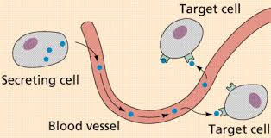
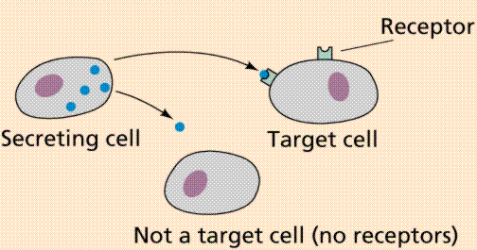

Slide 75
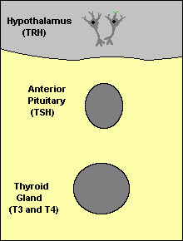
Feedback Control of Hormone Production
Feedback loops are used extensively to regulate secretion of hormones in the hypothalamic-pituitary axis. An important example of a negative feedback loop is seen in control of thyroid hormone secretion

Slide 76
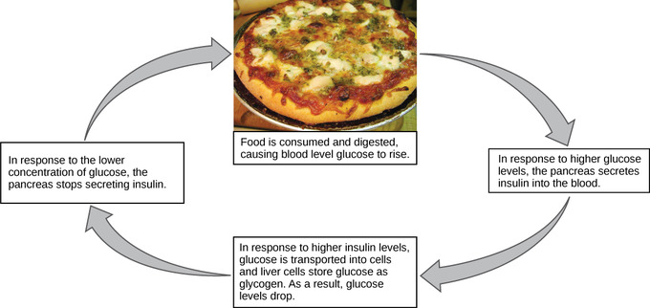
Negative feedback
The term feed-back was first applied to endocrine control systems by Roy G. Haskins (1930)

Slide 77
An example of a feedback loop
A certain item in the blood decreases
A certain area of the brain senses this decrease
A certain hormone is released
This hormone stimulates the release of another hormone
This other hormone stimulates the release of the hormone which was sensed to be decreased in the first place, causing it to be increased to desired level

Slide 78
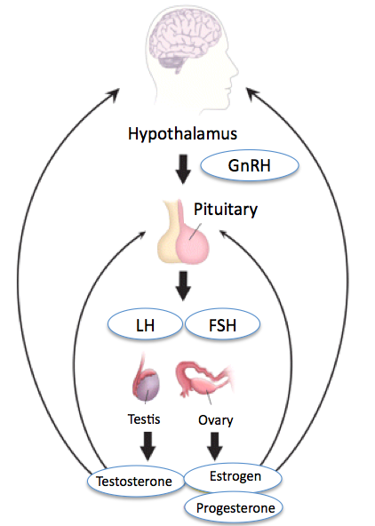

Slide 79
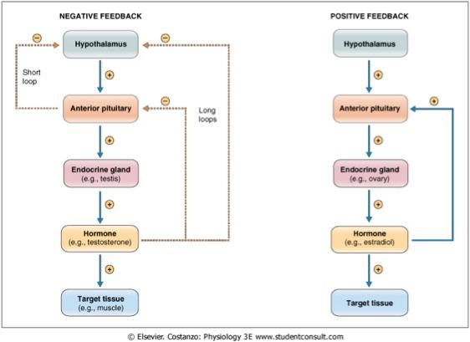

Slide 81
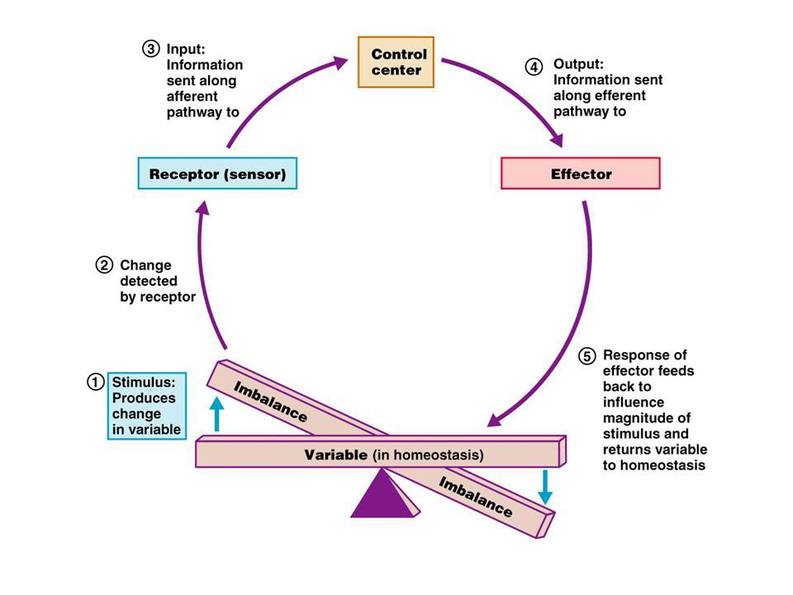

Slide 82
The Parathyroid Glands
Most people have four
On posterior surface of thyroid gland
(sometimes embedded)

Slide 83
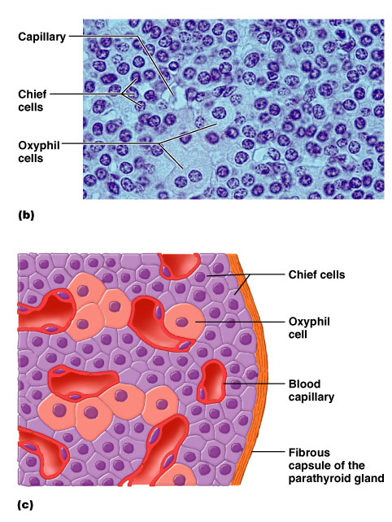
Parathyroids (two types of cells)
Rare chief cells
Abundant oxyphil cells (unknown function)
Chief cells produce PTH
Parathyroid hormone, or parathormone
A small protein hormone

Slide 84
Function of PTH (parathyroid hormone or “parathormone”)
Increases blood Ca++ (calcium) concentration when it gets too low
Mechanism of raising blood calcium
Stimulates osteoclasts to release more Ca++ from bone
Decreases secretion of Ca++ by kidney
Activates Vitamin D, which stimulates the uptake of Ca++ from the intestine
Has opposite effect on calcium as calcitonin (which lowers Ca++ levels)

Slide 85
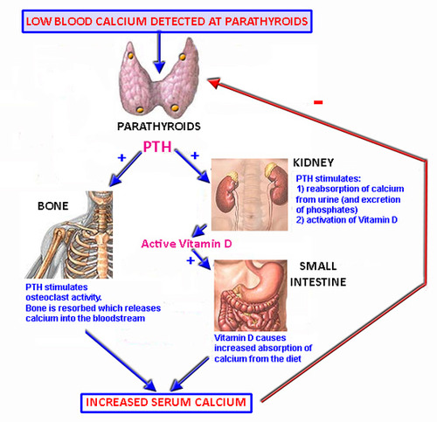

Slide 86
Parathyroid hormone (PTH) promotes absorption of calcium from the bone in 2 ways.
The rapid phase brings about a rise in serum calcium within minutes and appears to occur at the level of the osteoblasts and osteocytes
The slow phase of bone resorption occurs over several days and has 2 components.
First, osteoclasts are activated to digest formed bone,
second, proliferation of osteoclasts occurs

Slide 87
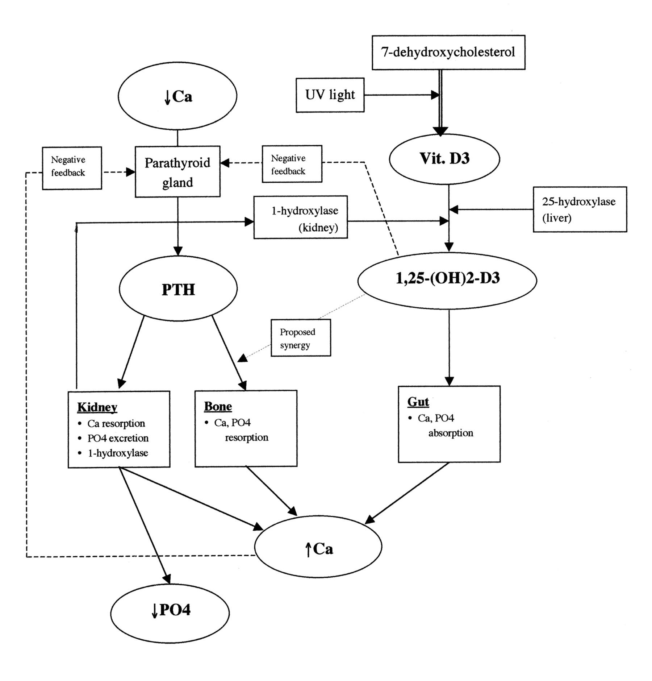

Slide 88
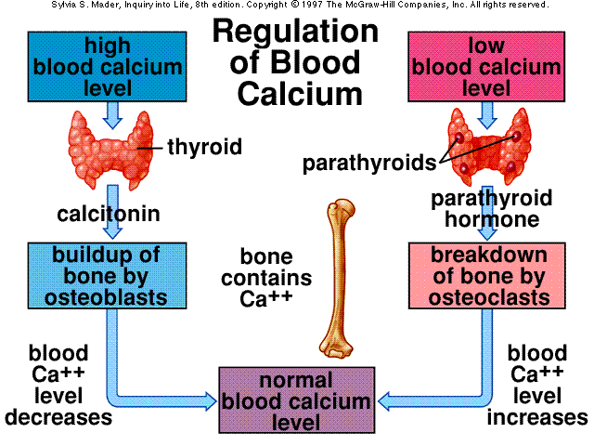

Slide 89
Types of endocrine disease
Endocrine disorders may be subdivided into three groups :
Endocrine gland hyposecretion (leading to hormone deficiency)
Endocrine gland hypersecretion (leading to hormone excess)
Tumours (benign or malignant) of endocrine glands

Slide 90
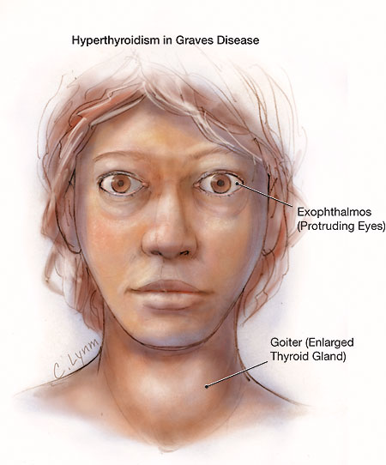
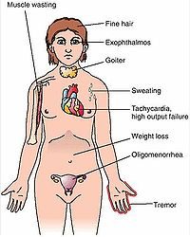

Slide 91
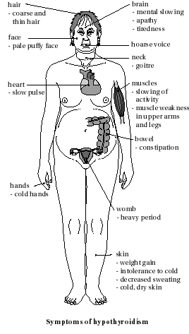
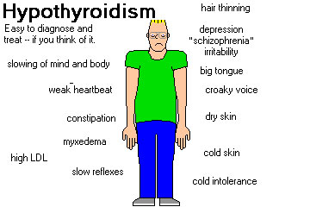

Slide 94
Hormon as a medication
Many hormones and their analogues are used as medication.
The most commonly prescribed hormones are estrogen and progestagens (as methods of hormonal contraception and as HRT), thyroxine (as levothyroxine, for hypothyroidsm) and steroids (for autoimune disease and several respiratory disorders).

Slide 95
insulin is used by many diabetics.
Local preparations for use in otolaryngology often contain pharmacologic equivalents of adrenalin
steroid and vitamin D creams are used extensively in dermatological practice.

Slide 96
A "pharmacologic dose" of a hormone is a medical usage referring to an amount of a hormone far greater than naturally occurs in a healthy body.
The effects of pharmacologic doses of hormones may be different from responses to naturally-occurring amounts and may be therapeutically useful.
.

Slide 97
An example is the ability of pharmacologic doses of glucocorticoid to suppress inflammation

