Slide 1
THE RESPIRATORY SYSTEM I Prasetyastuti Dept Of Biochemistry FACULTY OF MEDICINE PUBLIC HEALT AND NURSING UGM

Slide 2
TOPIC
Respiratory Tract
Pulmonary Ventilation
Lung volumes and capacities
Gas Exchange
Transport of oxygen and carbon dioxide
Respiratory Control
Disorders on Respiratory System

Slide 3
1. Respiratory Tract
The Respiratory system consist of
I. Structurally
1. The upper respiratory system
a. Nose
b. Pharynx ( throat)
2. The lower respiratory system
a. Larynx
b.Trachea
c. Bronchi
d. Lungs

Slide 4
II. Functionally
1. The conducting zone
a . nose
b. pharynx ( throat)
c. larynx
d. trachea
e. bronchi
f. bronchioles and terminal bronchioles
--→ filter, warm, moisten air and conduct it into
the lungs

Slide 5
2. The respiratory zone
a. respiratory bronchioles
b. alveolar ducts
c. alveolar sacs
d. alveoli
-→ gas exchange between air and blood

Slide 6
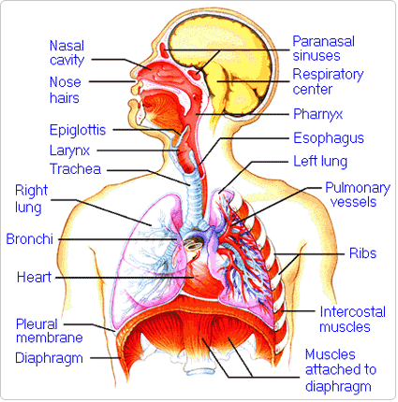

Slide 7
The function of Respiratory system :
- gas exchange
- participates in regulating blood pH
- contains receptor for the sense of smell
- filters inspired air
- produces sounds
- rides the body of some water and heat in exhaled air

Slide 8
NOSE
- The External nose:
The bony framework
- the frontal bone,
- nasal bones
- maxillae
The cartilaginous framework
- the septal cartilago the lateral - nasal cartilages
- the alar cartilages

Slide 9
The function of the interior structures of the external nose :
1. warming, moistening, and filtering incoming air
2. detecting olfactory stimuli
3. modifying speech vibrations
The NASAL CAVITY (nose) is the preferred entrance for outside air into the Respiratory System. The hairs that line the inside wall are part of the air-cleansing system.

Slide 11
PHARYNX (throat)
The functions :
- A passageway for air and food.
Provides a resonating chamber for speech sound
House the tonsil, which participate in immuno
logical reactions against foreign invaders.
- Collects incoming air from the nose and passes it downward to the trachea (windpipe).

Slide 12
The region of the pharynx
Nasopharynx : the superior portion
Oropharynx
Laryngopharynx
The muscles of the entire pharynx :
an outer circular layer
an inner longitudinal layer

Slide 13
Nasopharynx :
the superior portion of the pharynx
Lies posterior to the nasal cavity and extends to the soft palate
Receives air from the nasal cavity
There are 5 openings in its wall
- 2 internal nares
- 2 openings that lead into the auditory
tubes
- 1 opening into the oropharynx

Slide 14
Oropharynx
- the intermediate portion of the pharynx
lies posterior to the oral cavity and extends from the soft palate inferiorly to the level of the hyoid bone
has respiratory and digestive functions
- serving as a common passageway for air, food, and drink
- two pairs of tonsils, the palatine and lingual tonsils.

Slide 15
-
Laryngopharynx /hypopharynx
Inferior portion of the larynx
A respiratory and a digestive pathway

Slide 16
LARYNX/VOICE BOX
a short passageway that connects the laryngopharynx with the trachea
-the wall of the larynx is composed of 9 pieces of cartilage:
- 3 occur singly (thyroid ,epiglottis and
cricoid cartilage)
- 3 occurs in pairs (arytenoid, cuneiform
and corniculate cartilages)

Slide 17
- Arytenoid cartilages→ the most important: influence changes in position and tension of vocal fold.
- contains the vocal cords. It is the place where moving air being breathed in and out creates voice sounds.
The extrinsic muscles of the larynx connect the cartilages to other structures in the throat.
The intrinsic muscles connect the cartilages to one another.

Slide 18
The thyroid cartilage (Adam’s apple)
- consist of two fused plates of hyaline cartilage that form the anterior wall of the larynx and give it a triangular shape.
- present in males & females, but large in male
due to the influence of male sex hormones
on its growth during puberty

Slide 19
The epiglottis
- leaf shaped pieces of elastic cartilage that
is covered with epithelium
- during swallowing, the pharynx and the larynx rise
- elevation of the pharynx widens it to receive food of drink
- elevation of the larynx causes the epiglottis
to move down and form a lid over the glottis,
closing it off.

Slide 20
- the closing of the larynx in this way during swallowing route liquids and foods into the esophagus and keep them out of the larynx and airways
The EPIGLOTTIS is a flap of tissue that guards the entrance to the trachea, closing when anything is swallowed that should go into the esophagus and stomach.

Slide 21
When dust, smoke, food or liquids pass into the
larynx----→ cough reflex occurs, usually expelling the material
The cricoid cartilages
Is a ring of hyaline cartilage that forms the inferior wall of the larynx
The thyroid cartilage is connected to the cricoid cartilage by the Cricothyroid ligament

Slide 22
The paired arytenoid cartilage
Attach to the vocal folds and intrinsic pharyngeal muscles.
intrinsic pharyngeal muscles contract and move the vocal folds to produce sounds
The paired corniculate cartilage:
supporting structures for the epiglottis
The paired cuneiform cartilage :
support the vocal folds

Slide 23
The ESOPHAGUS is the passage leading from the mouth and throat to the stomach.
TRACHEA/WINDPIPE
: is the passage leading from the pharynx to the lungs
The layers of the tracheal wall are
a. mucosa
b. submucosa
c. hyaline cartilage :
d. adventitia : joins the trachea to surrounding tissues

Slide 24
The mucosa of the trachea consists of
- an epithelial layer of pseudostratified ciliated columnar epithelium-→ consists of ciliated columnar cell and goblet cell and basal cells
- an underlying layer of lamina propia that contains elastic and reticular fibers.
The submucosa consists of areolar connective tissue that contains seromucous glands and their ducts
.

Slide 25
Hyaline cartilage : support so that the tracheal wall does not collapse inward( especially during inhalation ) and obstruct the air passageway
The adventia:
consists of areolar connective tissue that joins the trachea to surrounding tissues

Slide 26
BRONCHI
The trachea divides into the two main BRONCHI (tubes), one for each lung. These, in turn, subdivide further into bronchioles
- the trachea divides into :
a. a right primary bronchus
----→ goes into the right lung
more vertical, shorter, and wider than
the left
b. a left primary bronchus
----→ goes into the left lung

Slide 27
The primary bronchi divide to form smaller bronchi—
the secondary bronchi, one for each lobe of the lung
-→ the right lung has three lobes
The left lung has two lobes
The secondary bronchi continue to branch, forming smaller bronchi ---→ tertiary bronchi -→
divide into bronchioles----→ terminal bronchioles
--→bronchial tree
The smallest subdivisions of the bronchi are called BRONCHIOLES, at the end of which are the alveoli (plural of alveolus).

Slide 28
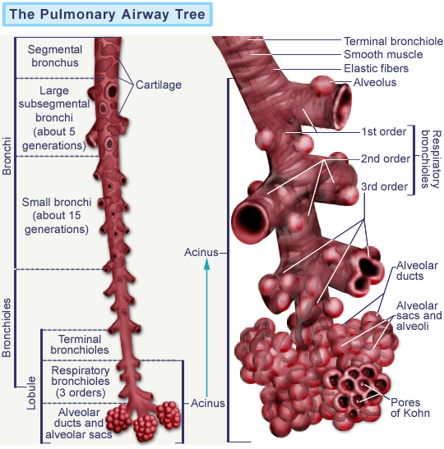

Slide 29
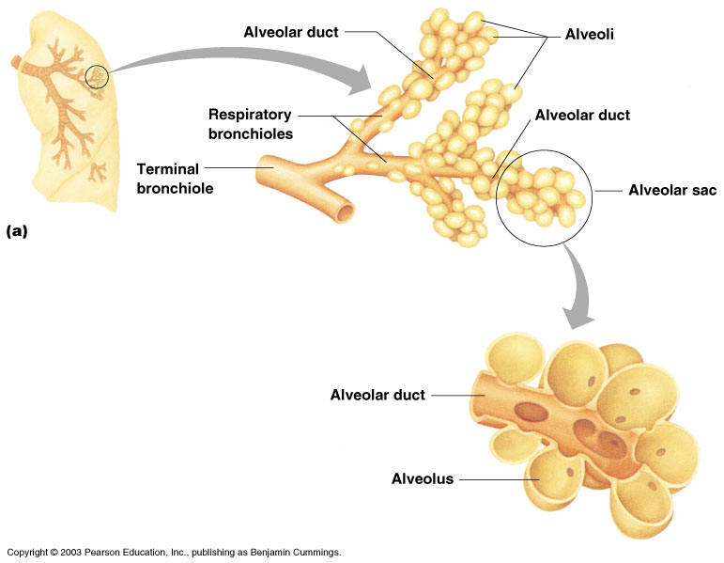

Slide 30
LUNGS
a paired cone-shaped organs in the toracic cavity are separated from each other by the heart and other structures in the mediastinum
Which divides the thoracic cavity into two anatomically distinct chambers.
Pleural membrane : enclose and protect each lung
Parietal pleura : the superficial layer

Slide 31
Visceral pleura : covers the lungs themselves
Pleural cavity : between the visceral and parietal pleurae contains a small amount of lubricating fluid secreted by the membranes -→
- reduces friction between the membranes slide easily over one another during breathing.
- Causes the two membranes to adhere to one another just as a film of water causes two glass slide to stick together,-→ surface tension.

Slide 32
Pleurisy/ pleuritis : inflammation of the pleural membrane
Pleural effusion : excess fluid accumulates in the pleural space
The DIAPHRAGM is the strong wall of muscle that separates the chest cavity from the abdominal cavity. By moving downward, it creates suction to draw in air and expand the lungs.

Slide 33
ALVEOLI
: the exchange of O2 and CO2 between the air spaces in the lungs and the blood takes place by diffusion across the alveolar and capillary walls
The lungs contain 300 million alveoli, surface area 70 m²
The walls of alveoli consist of two types of alveolar epithelial
1. Type I alveolar cells : the main sites of gas exchange
2. Type II alveolar cells : secrete alveolar fluid
(surfactant: a complex mixture of phospholipids and
lipoprotein--→ lowers the surface tension of
alveolar fluid , which reduces the tendency of alveoli
to collapse )

Slide 34
The respiratory membrane consists of four layers
1. A layer of type I and type II alveolar cells and associated alveolar macrophages that constitutes the alveolar wall
2. An epithelial basement membrane underlying the alveolar wall
3. A capillary basement membrane that is often fused to the epithelial basement membrane
4. The capillary endothelium

Slide 35
The ALVEOLI are the very small air sacs that are the destination of air breathed in.
The CAPILLARIES are blood vessels that are imbedded in the walls of the alveoli. Blood passes through the capillaries, brought to them by the PULMONARY ARTERY and taken away by the PULMONARY VEIN.

Slide 36
Blood supply to the lungs
The lungs receive blood via :
Pulmonary arteries and bronchial arteries
Deoxygenated blood passes through the pulmonary trunk( left pulmonary artery -→ enter the left lung and right pulmonary artery -→ enter the right lung)
Pulmonary arteries carry deoxygenated blood
-

Slide 37
Return of the oxygenated blood to the heart by way of the four pulmonary veins, which drain into the left atrium
Bronchial arteries
deliver oxygenated blood to the lungs

Slide 38
2. PULMONARY VENTILATION
Respiration : the process of gas exchange in
the body
1. Pulmonary ventilation / breathing
the inhalation and exhalation of air between the atmosphere and the alveoli of the lungs
2. External respiration : the exchange of gases between the alveoli and the blood in pulmonary capillaries across the respiratory membrane –--→pulmonary capillary blood gains O2 and loses CO2

Slide 39
3. Internal respiration
The exchange of gas between blood in systemic capillaries and tissue cell
--- the blood loses O2 and gains CO2
Factors Affecting Pulmonary Ventilation
* Air pressure differences during inhalation and exhalation
* Surface tensions of alveolar fluid
* Compliance of the lungs
* Airway resistance

Slide 40
Pressure Changes During Pulmonary Ventilation
Inhalation
Just before each inhalation,
the air pressure inside the lungs is equal to
the air pressure of the atm --→ + 760 mmHg
( 1 atm)
For air to flow into the lungs--→ the pressure inside the alveoli must become lower than the atm pressure ----→ by increasing the volume of the lungs.

Slide 41
Boyle’s law : inverse relationship between volume and pressure
The same number of molecules in half the volume produces twice the pressure
The main muscle of inhalation is
- the diaphragm (the most important muscle )
- external intercostals
contraction of the external intercostals is responsible for about 25 % of the air enters the lungs during normal quiet breathing.

Slide 42
During normal quiet breathing.
The diaphragm descends about 1 cm producing a pressure difference of 1-3 mm Hg and the inhalation about 500 ml of air
In strenuous breathing
Diaphragm descend 10 cm --→ produces a pressure difference of 100 mmHg and the inhalation 0f 2-3 liters of air
Contraction of the diaphragm is responsible for about 75 % of the air that enters the lungs

Slide 43
Exhalation : breathing out: expiration
The pressure in the lungs is greater than
the pressure of the atmosphere
Passive process because no muscular
contractions.
Starts when the inspiratory muscles relax
* Becomes active only during forceful breathing (exercise )--- muscle of exhalation – the abdominals and internal intercostals --→ contract---→
Pressure in the abdominal region & thorax increases

Slide 44
Surface tension of Alveolar Fluid
Surface tension arises at all air-water interfaces because the polar water molecules are more strongly attracted to each other than they are to gas molecules in the air.
During breathing,
-- surface tension must be overcome to expand the lungs during each inhalation
During exhalation
---surface tension also accounts for two-thirds of lung elastic recoil, which decreases the size of alveoli

Slide 45
The surfactan
- a mixture of phospholipids and lipoproteins
- present in alveolar fluid reduces its surface
tension below the surface tension of pure
water
- deficiency of surfactant in premature
infants causes respiratory distress
syndrome the alveoli do not remain open
due to a lack of surfactan
- Administered directly into the lungs oxygen

Slide 46
The surface tention of alveolar fluid is greatly increases-→ alveoli collapse
The condition is also more common in infants whose mother have DM, in male.

Slide 47
* Compliance of the lungs
Compliance refers to how much effort is required to stretch the lungs and chest wall
--- high compliance : the lungs and chest wall
expand easily
---low compliance : resist expansion
Two principle factors :
- elasticity and
- surface tension

Slide 48
The lungs normally have high compliance and expand easily --→ because
- elastic fibers in lung tissue are easily
stretched and
- surfactant in alveolar fluid reduces surface
tension
Decreased compliance is a common feature in pulmonary conditions
1. scar lung tissue ( TB)
2. cause lung tissue to become filled with fluid
3. produce a deficiency in surfactant
4. impede lung expansion in any way

Slide 49
Airway resistance
Depends of
- the pressure difference
- the resistance
- the degree of contraction or relaxation of smooth muscle in the wall of the airway
During inhalation the lungs expand, the bronchioles enlarge because their walls are pulled outward in all direction.

Slide 50
Larger diameter airways --- decreased
resistance
During exhalation – airway resistance
increase ---Diameter of bronchioles
decreases.

Slide 51
3. Lung volumes and capacities
At rest a healthy adult averages 12 breaths /minute
Each inhalation and exhalation moving about 500 ml of air into and out of the lungs
Tidal Volume ( V_{T}) : volume of one breath
The minute ventilation (MV) :
The total volume of air inhaled and exhaled each minute
MV = 12 breath/min X 500 ml/breath
= 6 liters/min

Slide 52
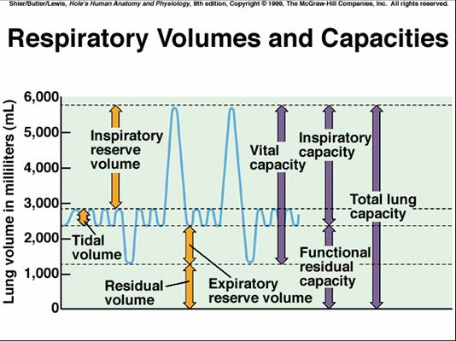

Slide 53
Tidal volume
In a typical adult :
70% of tidal volume (350 ml) actually reaches the respiratory zone of the respiratory system
30% (150 ml) remains in the conducting airways of the nose, pharynx, larynx, trachea, bronchi, bronchioles, and terminal bronchioles

Slide 54
Lung capacities:
Combinations of specific lung volumes
The sum Inspiratory capacity
of tidal volume and inspiratory reserve volume
In males : 500 ml + 3100 ml = 3600 ml
In females : 500 ml + 1900 ml = 2400 ml

Slide 55
Functional residual capacity
The sum of residual volume and expiratory reserve volume
In males : 1200 ml + 1200 ml = 2400 ml
In females : 1100 ml + 700 ml = 1800 ml
Vital capacity
The sum of inspiratory reserve volume, tidal volume, and expiratory reserve volume
In male : 4800 ml
In female : 3100 ml

Slide 56
Total lung capacity
The sum of vital capacity and residual volume
In male 4800 ml + 1200 ml – 6000 ml
In female 3100 + 1100 = 4200 ml

